Slide 1
EEGR 471
WEEK 1

Slide 2
Week 1: BACKGROUND
IC’s are an integral part of daily life in 2023. Included in everything from phones, TV’s, Laptops, Watches, earphones, and yes even Fridges. Post picture of Samsung fridge.

Slide 3
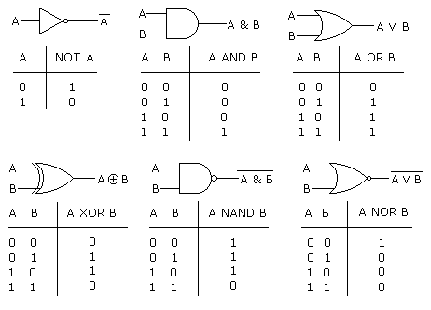
Logic Gates

Slide 4
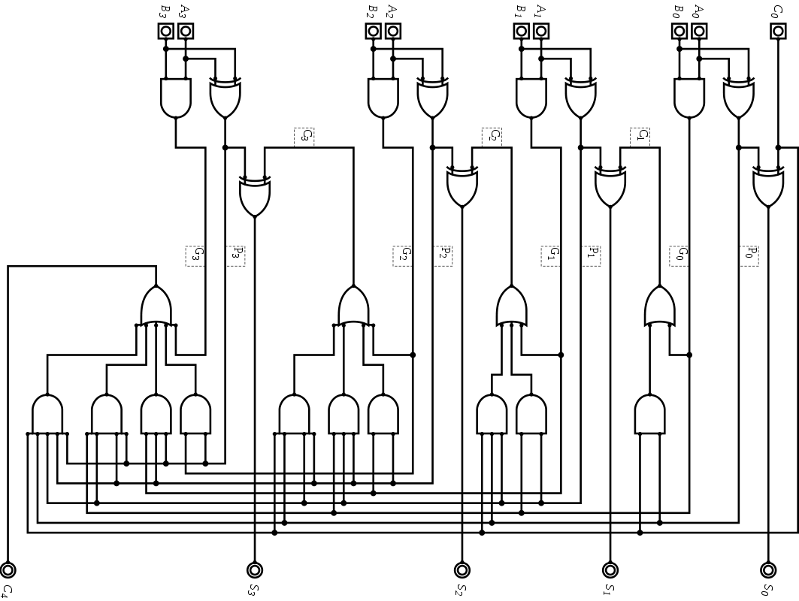
Sea of Gates

Slide 5
Digital IC FLOW
Specification
Requirements Negotiation | Verification
RTL Logic Design | Verification
Synthesis | Verification
Implementation & (Place & Route) | Verification
Bitstream or Layout (GDSII) | Validation | Emulation
Specification
Requirements Negotiation
RTL Logic Design
Synthesis
Bitstream or Layout (GDSII)
Specification Review
Test Plan
RTL Simulation
Formal Verification
Post- Synthesis Verification
Equivalence checking
Validation
Emulation
Implementation & (Place & Route)
Post-implementation Verification

Slide 6
IC Manufacturing Cost
$250+ million investment just to get started.
Bugs found pre-fab cost you lines of Code, bugs found after tapeout cost millions.
Respin (design correction and re-fabrication) is long and costly
  Around $25 million per respin.
Best chance of minimizing bugs ???
  Proper Verification

Slide 7
Test Plan
Specification document that captures all the details needed for verifying a given design.
Verification engineer is responsible for developing this plan initially as he understands the details of the DUT (Design under Test).
Critical in avoiding failures later in a project.
  which can include bug escapes
  re-working several infrastructure work / time crunches
  loosing on quality/features.
What, How, When

Slide 8
What to Verify
Test plan should list down details on what all features of design to be verified.
List all features that should will be tested as individual test items.
Account for all supported design configurations (register settings) under which features should be tested as test plan items.
capture specific micro-architectural cases that needs to be ensured for correctness.
  state machines, FIFOs, arbitration and other logical block interactions
specific stimulus patterns, interactions, high level usage scenarios, potential deadlock/livelock conditions

Slide 9
How to Verify
Determine the best way to verify each test item.
Most items will be checked by functional verification and constrained random stimulus.
Some will be best covered by Formal Verification
Some can be checked by emulation
Some items will be checked by Visual inspection
figure out how best each of the items can be verified

Slide 10
When to Verify
Project timeline.
  Verifiers expected to test more and more, in less and less time.
Test plan needs to capture estimates for timeline of completion.
Estimates should be modular. Parallelize when possible.
Determine Item priorities based on schedule. Usually at least three.
  High, Medium, Low

Slide 11
Parallel verification
Testbench development
stimulus patterns
Testing and regression
Top Level
Sub-modules
Coverage analysis
Debug and Signoff

Slide 12
Logic Simulation
Need a way to check that RTL (Register transfer level) Hardware description is doing what we expect it to do.
Simulate how logic designed will behave when given certain stimulus.
Simulation environment is usually controlled by a top level testbench that instantiates the design as a DUT.
Often with a waveform to view data flow into and through design.

Slide 13
Simulation: Cycle based vs Event Based
Cycle Based:
  Computes steady state response of a circuit at each clock cycle.
  It does not simulate detailed circuit timing, but instead computes the steady state response of a circuit at each clock cycle.
  Lack of detailed circuit timing means the user cannot see the glitch behavior of signals between clock cycles.
  User observes circuit signals once per clock cycle. Cycle based simulators work only with synchronous designs.

Slide 14
Simulation: Cycle based vs Event Based
Intermediary and output signals update whenever there’s a change in an input signal.
Allows for simulating designs with possible glitches.
Allows for post-synthesis and timing-based simulation.
Event based simulation very slowed compared to Cycle based since it must simulate much more behavior.

Slide 15
Verilator
  Verilator is a tool that compiles Verilog and SystemVerilog sources to highly optimized (and optionally multithreaded) cycle-accurate C++ or SystemC code.
  The converted modules can be instantiated and used in a C++ or a SystemC testbench, for verification and/or modelling purposes.

Slide 16
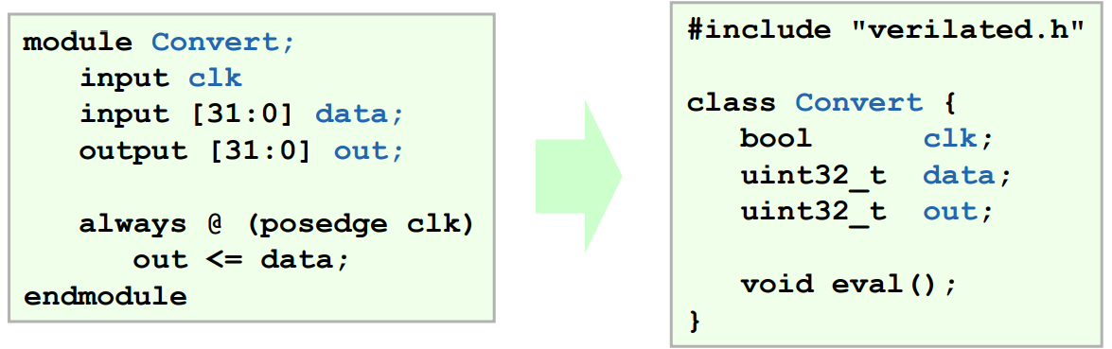
Conversion
The top wrapper looks similar to the top Verilog module.
Inputs and outputs map directly to bool, uint32_t, uint64_t, or array of uint32_t’s:
Notes:
Verilator Internals, July 2005

Slide 17
Testbench Basics
Driver
  Drives the generated stimulus to the design
Monitor
  Monitor the design input-output ports to capture design activity
Scoreboard
  Checks output from the design with expected behavior

Slide 18
Testbench Basics
Template
  Dummy template that declares inputs to and outputs from Design under test (DUT), then instantiates the DUT.

Slide 19
Class based Verification Tests

Slide 20
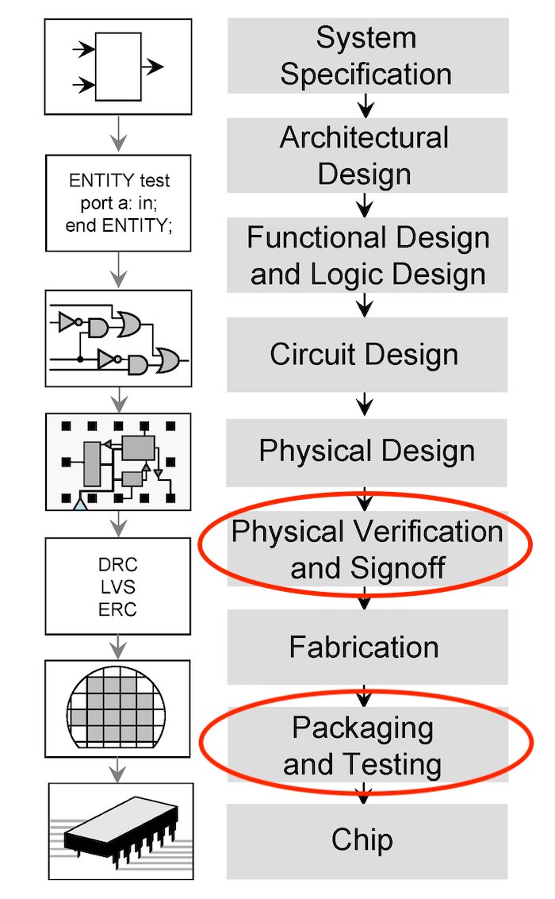
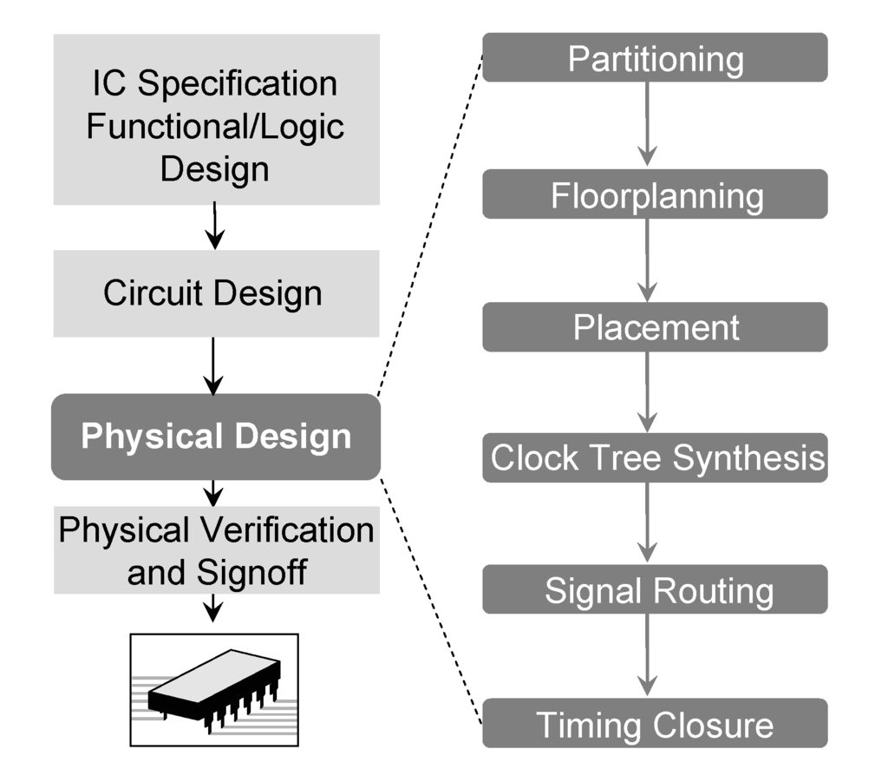
Notes:
Image Source: Wikimedia / Linear77 CC BY 3.0, Image Source: What Really is the Difference Between Test and Verification

Slide 21
Module Compilation
Use one of the modules on the RISC-V CORE

